Slide 1


“How to differentiate between Activity
Limitation & Causal Impairments
when assessing in PNF courses?”
Leandro Giacometti &Shin, Seung Sub
IPNFA® Instructor

Slide 2
RATIONALE/HISTORY
During co- teaching discussions on the topic
Submit a short survey to check the opinion of Instructors
2 objective / 2 subjective questions
19 answers

Slide 3
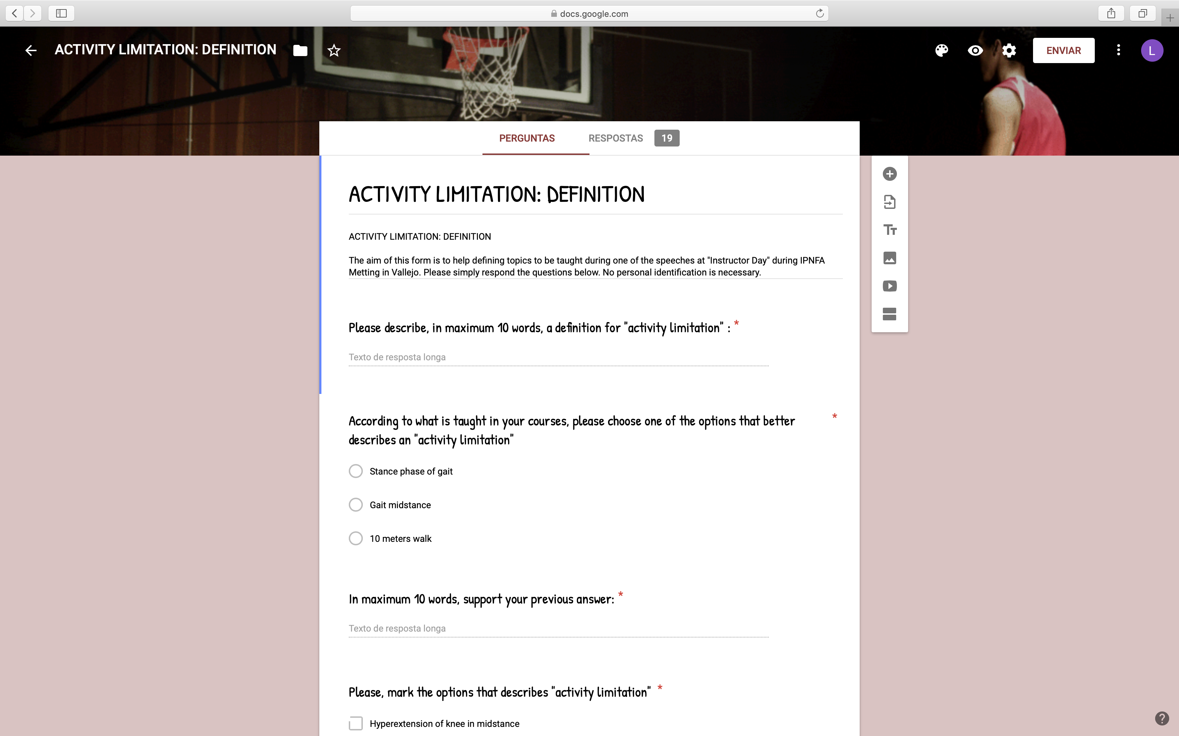

Slide 4
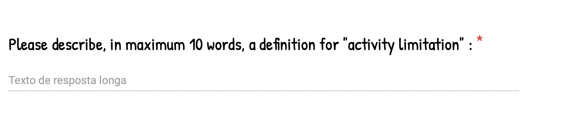
After WHO: a difficulty encountered by an individual in executing a task or action
Impairment in doing every day task, out of the social life situation.
Impaired capacity to execute a desired task or function
Problems in executing a meaningful task, hence a movement with a purpose.

Slide 5
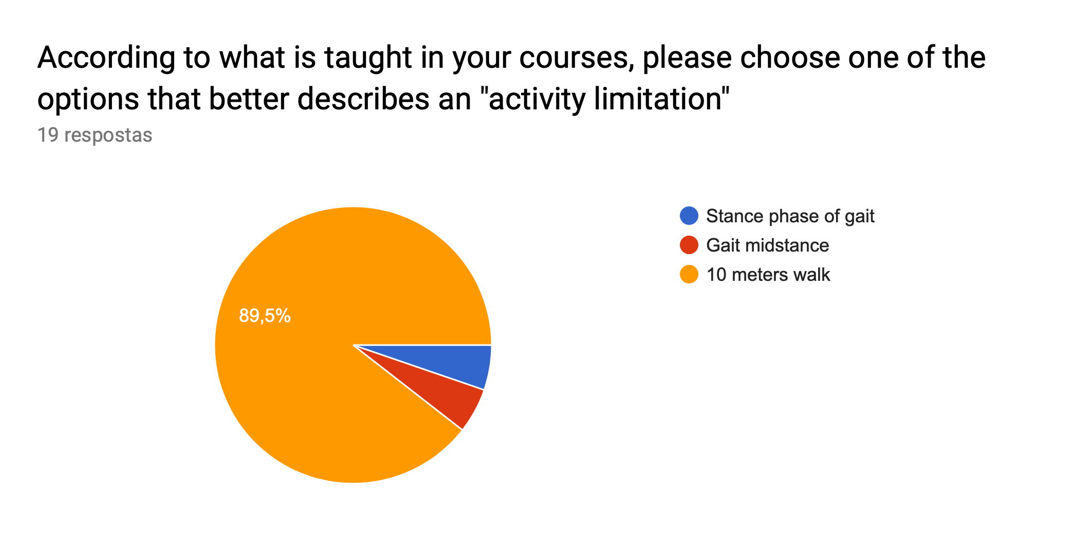
17
5,3%
1
5,3%
1

Slide 6
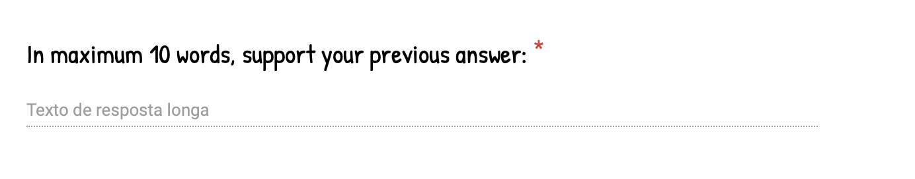
The answers are not describing activity limitations
None of them because is does not describe the limitation only the activity
None, neither the 10 m walk.

Slide 7
Stance Phase of gait is bodyfunction, if Patient complains unsave gait while Standing on a leg, it is AL
Parts of the gait are considered functions.
Midstance could be just a Function. STP as well
The other two are functions of gait.
The other two are functions of gait.
Gait is a body function, walking is gait with a purpose, eg. Walking to the toilet.

Slide 8
Gait as a whole is an activity which can be limited, aspects of the gait cycle are part of that activity.
Two first answers are part of one activity-gait
10m gait represents whole task vs. stance phase as part-task

Slide 9
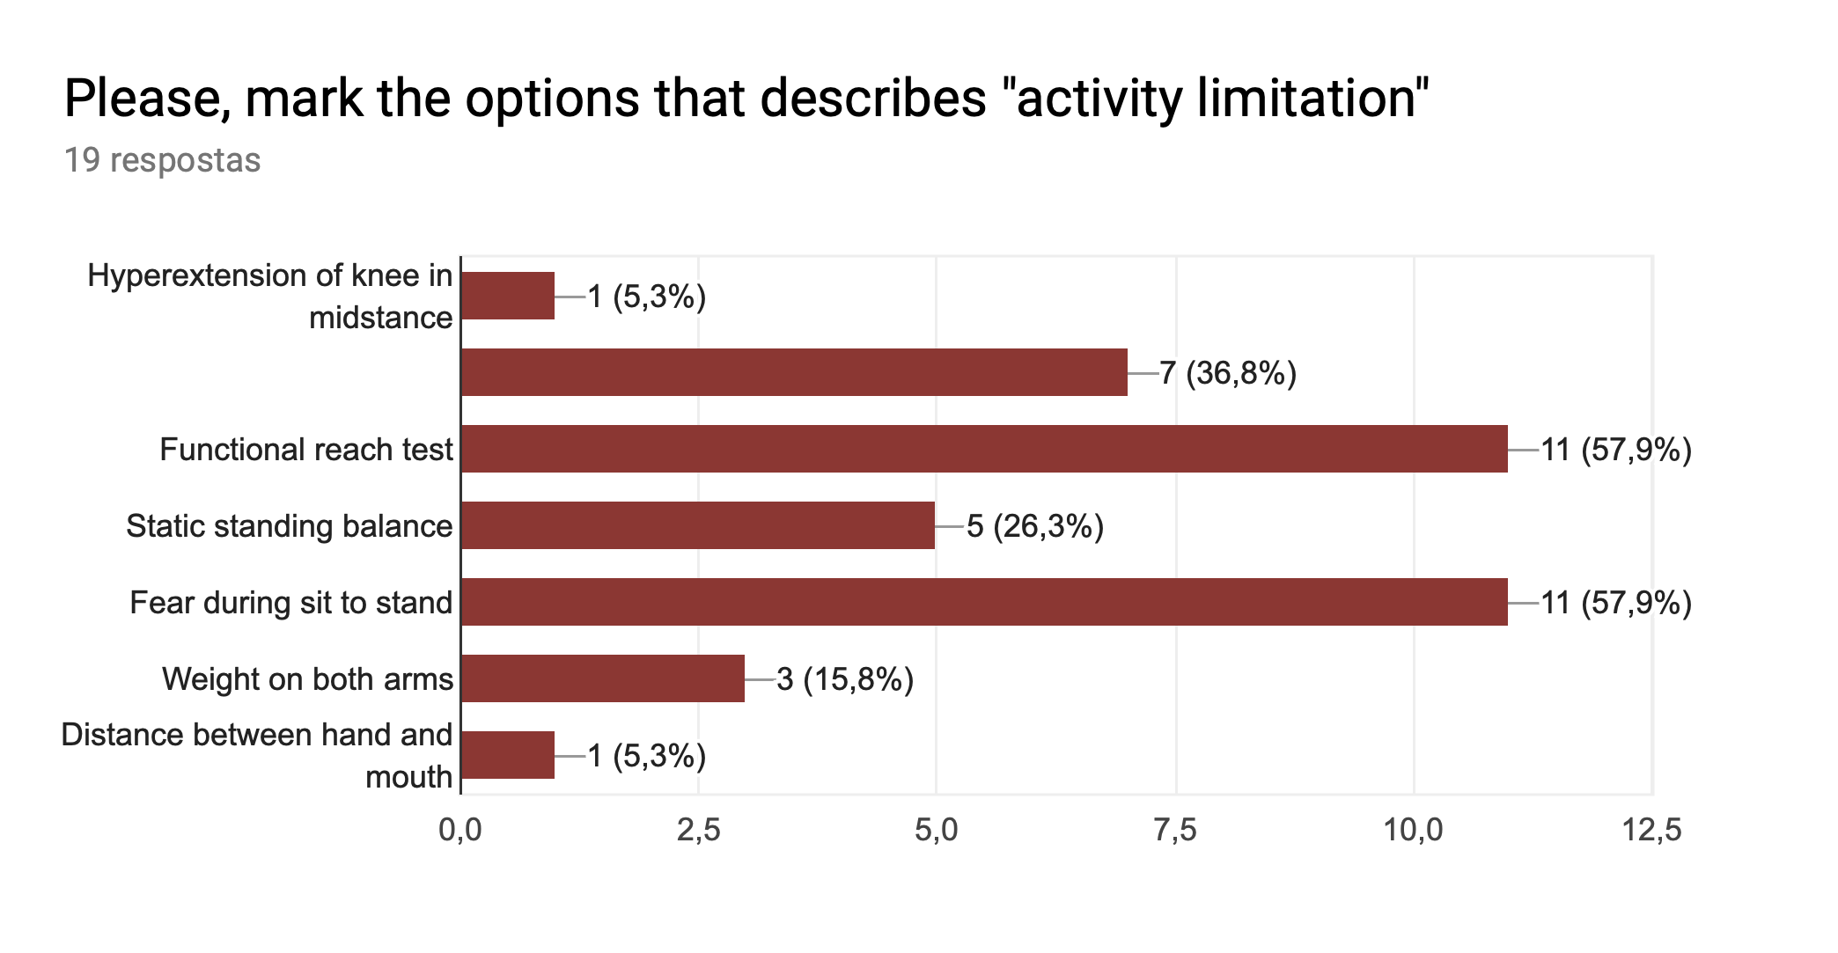
Distance Hand and mouth in sitting

Slide 10
Contents
Introduction
Activity and Body S/F in ICF
Tests for Activity and Body S/F
Answers of questionnaire
Reasons
Concluding remarks

Slide 11
Introduction
During PNF basic, 3a/b or 4 course, instructors assess patients’ AL and CIs differently from each other.
Sometimes, activity limitation in 3a course becomes causal impairment in 3b course.

Slide 12
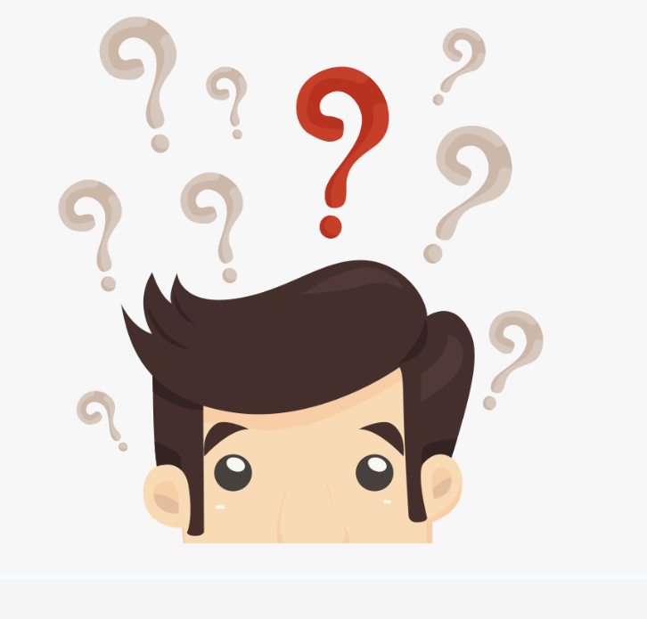
Introduction
Participants are really confused !!!!

Slide 13
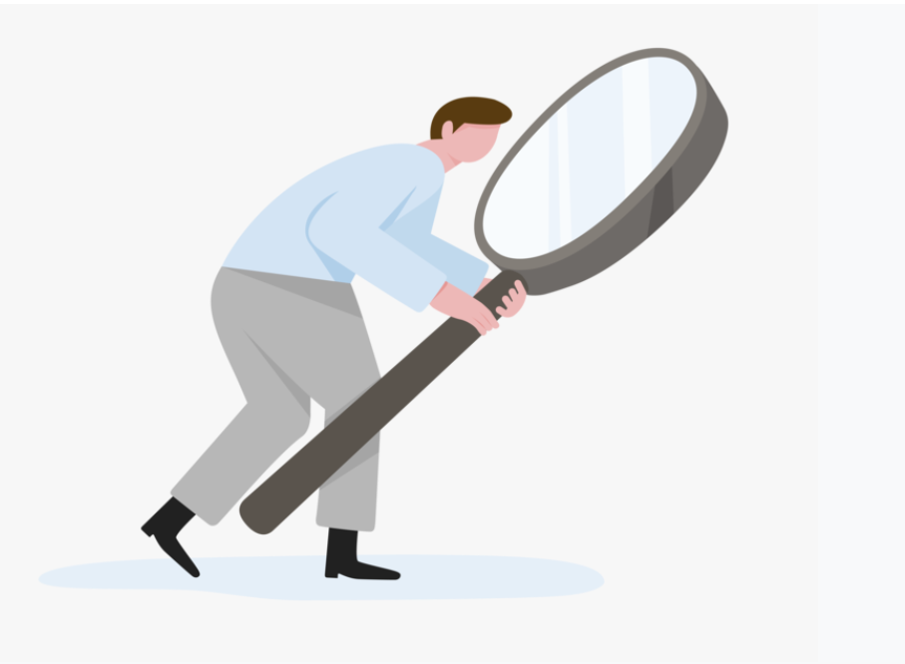
Introduction
Purpose of this presentation is to find out why instructors have different point of view using ICF in PNF course.
…Activity
Body S/F…

Slide 14
Introduction
And then We would like to provide a trigger for finding a solution.
…Activity
Body S/F…

Slide 15
Question
Can you differentiate between Activity Limitation & Causal Impairments when assessing patients during your courses?
Hyperextension of knee in mid-stance
The distance between mouth and hand
Functional reach test
Static standing balance
Pediatric Balance Scale
Fear during siting to standing
Weight either on the arms
Notes:
슬랙라인(Slack Line)

Slide 16
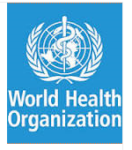
ICF Model
ICF
  International Classification of Functioning, Disability and Health
  To provide a conceptual basis and a universal common language for understanding and describing patients' health status, reaching beyond mortality, diseases, and medical diagnoses.
  (WHO, 2001)
3S PNF
Notes:
contextual factors: 전후관계
Contextual factors are characteristics of the environment that are related to the effectiveness of a collaboration

Slide 17
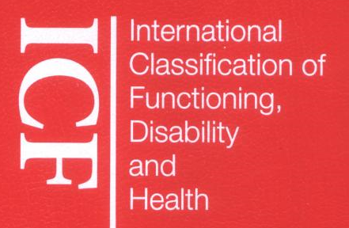
Health Condition (disorder/disease)
ICF Model
Body function
& structure (Impairment)
Activities
(Limitation)
Participation
(Restriction)
Environmental Factors
Personal Factors
Contextual factors
Notes:
17
The ICIDH-2 classifies functioning at both the level of body/body part, whole person, and whole person in social context. Disablements are:
losses or abnormalities of bodily function and structure (impairments),
limitations of activities (disabilities),
restrictions in participation (formally called handicaps).
The diagram shows that disablement and functioning are outcomes of interactions between health conditions and contextual factors. The interaction is complex, bi-directional and dynamic. The model does not posit a causal linkage between the three dimensions of disablement; rather, at each level, disablement occurs within and by means of contextual factors. Two sorts of contextual factors are identified: social and physical environmental factors (social attitudes, architectural characteristics, legal and social structures, as well as climate, terrain and so forth); and personal factors that include gender, age, other health conditions, coping styles, social background, education, profession, past and current experience, overall behaviour pattern, character style and other factors that influence how disablement is experienced by the individual. The ICIDH-2 classifies functioning at both the level of body/body part, whole person, and whole person in social context. Disablements are:
losses or abnormalities of bodily function and structure (impairments),
limitations of activities (disabilities),
restrictions in participation (formally called handicaps).
The diagram shows that disablement and functioning are outcomes of interactions between health conditions and contextual factors. The interaction is complex, bi-directional and dynamic. The model does not posit a causal linkage between the three dimensions of disablement; rather, at each level, disablement occurs within and by means of contextual factors. Two sorts of contextual factors are identified: social and physical environmental factors (social attitudes, architectural characteristics, legal and social structures, as well as climate, terrain and so forth); and personal factors that include gender, age, other health conditions, coping styles, social background, education, profession, past and current experience, overall behaviour pattern, character style and other factors that influence how disablement is experienced by the individual.

Slide 18
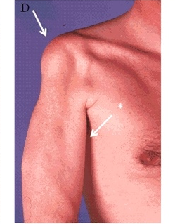
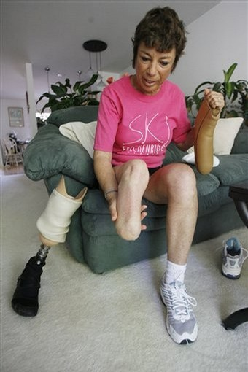
Body Functions/ Structures
Body Functions
  physiological functions of body systems (including psychological functions).
Body Structures
  anatomical parts of the body such as organs, limbs and their components.
Impairments
  problems in body function or structure such as a significant deviation or loss.

Slide 19
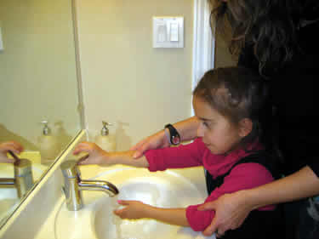
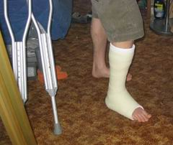
Activity
Activity
  the execution of a task or action by an individual.
  Activity of daily living
  The personal level
Activity Limitations
  difficulties an individual may have in executing activities.
3S PNF

Slide 20
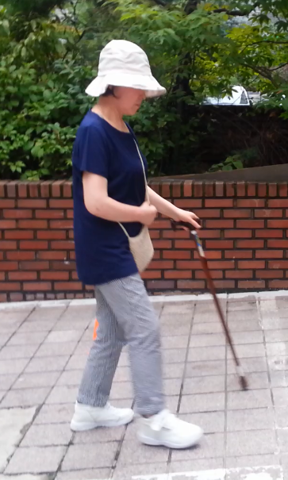
Different points of views
Body S/F
Activity
Body alignment
Muscle strength
Joint mobility
Sensation
Control of voluntary movement
Involuntary movement, movement reaction
Gait pattern
Etc.
Time, repetition or distance of performed activity
Level of Independence or assist
Etc.

Slide 21
Whenever I walk fast, I’m embarrassed about being flexed elbow.
Body S/F
Activity
Embarrass
ROM of elbow flexion
Walking speed
The Level of assist

Slide 22
Whenever I walk fast, I’m embarrassed about being flexed elbow.
Body S/F
Activity
Embarrass
ROM of elbow flexion
Walking speed
The Level of assist
Make a Hypothesis why her elbow is flexed !
  Muscle weakness (trunk, elbow extensor), shortened calf, sensation deficit, out of control of eccentric contraction of quadriceps or calf

Slide 23
Reasons of difference between instructors
It is possible to assess the time, repetitions or distance of performed activity for activity.
But it is also possible to assess the time, repetitions or distance of performed movement for body function.

Slide 24
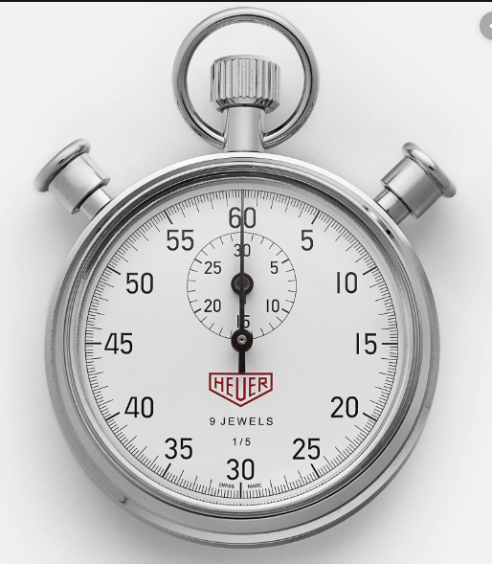
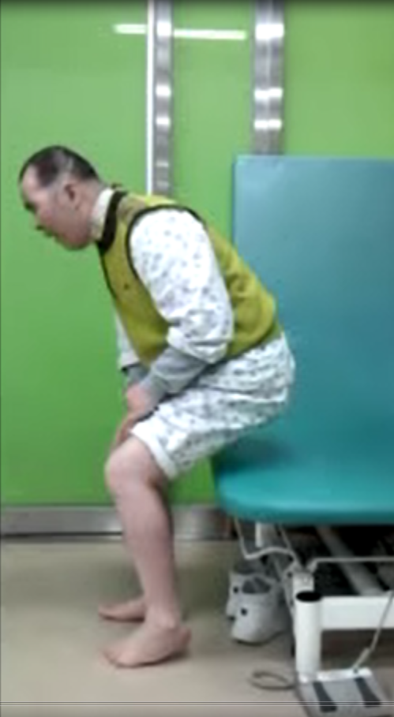
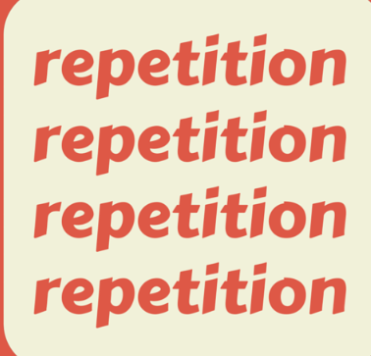
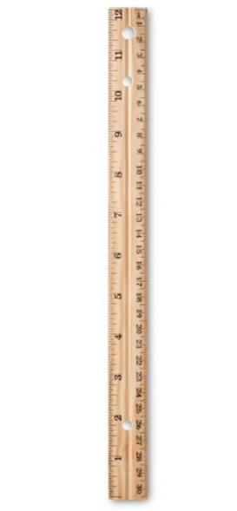
Siting to standing

Slide 25
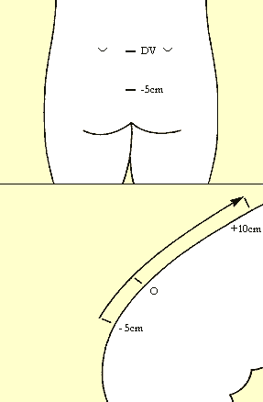
Modified Schober test
The examiner makes a mark approximately at the level of lumbosacral joint.
One point 5 cm below lumbosacral joint
Another point, 10 cm above lumbosacral joint.
The patient is asked to touch his/her toes.
However, a restriction in the lumbar flexion of the patient reduces this increase; if the distance increases less than 5 cm .
For RA, Ankylosing spondylitis

Slide 26
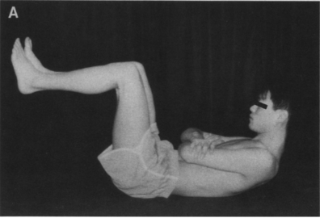
Lumbar Trunk muscle Endurance Test

Slide 27
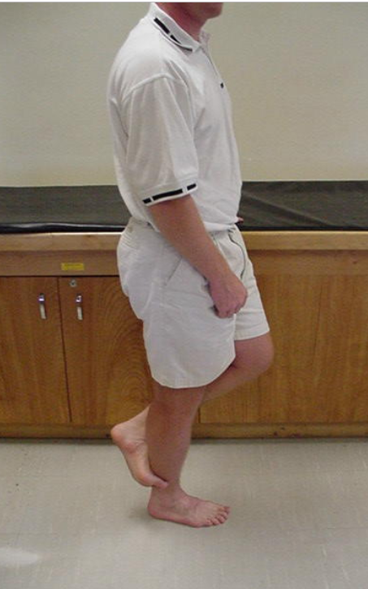
MMT of ankle plantar flexor
Notes:
20 times heel rise (Perry, 1992),
25 times heel rise (Daniels & Worthingham, 2007)

Slide 28
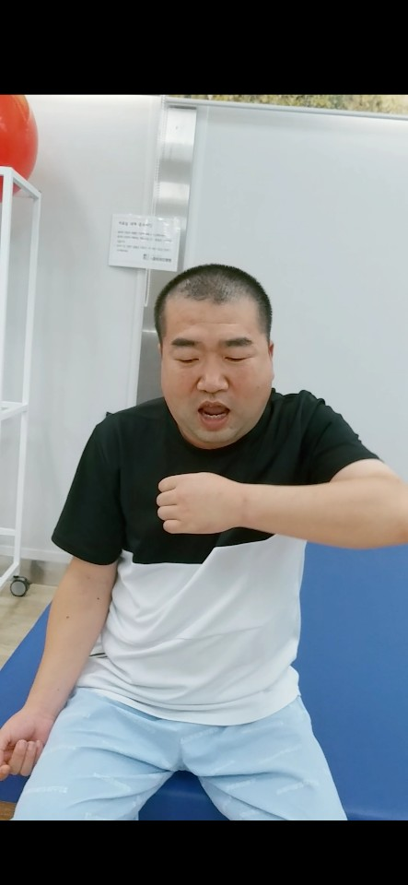
The distance between mouth and hand
Body S/F
b710, b710
Body alignment
Muscle strength
Joint mobility
Sensation
Control of voluntary movement
Involuntary movement, movement reaction
Gait pattern
Etc.

Slide 29
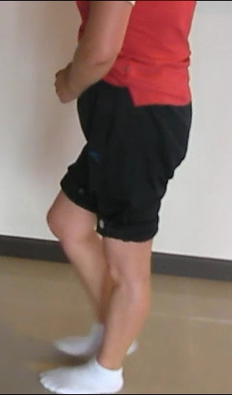
Hyperextension of knee in mid-stance

Slide 30
Hyperextension of knee in mid-stance
Body S/F
b770
Gait pattern function
functions of movement patterns associated with walking, running or other whole body movements
E.g.) spastic gait, hemiplegic gait, paraplegic gait, asymmetric gait,.

Slide 31
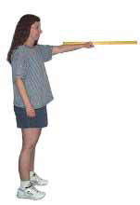
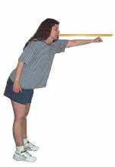
Functional reach test
Activity
4 Mobility
d4106 Shifting the body’s center of gravity
adjusting or moving the weight of the body from one position to another while sitting, standing or lying, such as moving from one foot to another while standing

Slide 32
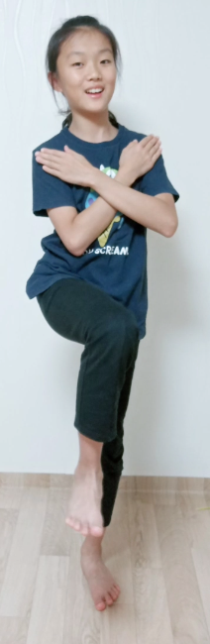
Standing static balance
Activity
4 Mobility
d4154 Maintaining a standing position
staying in a standing position for some time as required

Slide 33
Fear during siting to standing
Body S/F
b152 Emotional functions
b1522 Range of emotion
mental functions that produce the spectrum of experience of arousal of affect or feelings such as love, hate, anxiousness, sorrow, joy, fear and anger

Slide 34
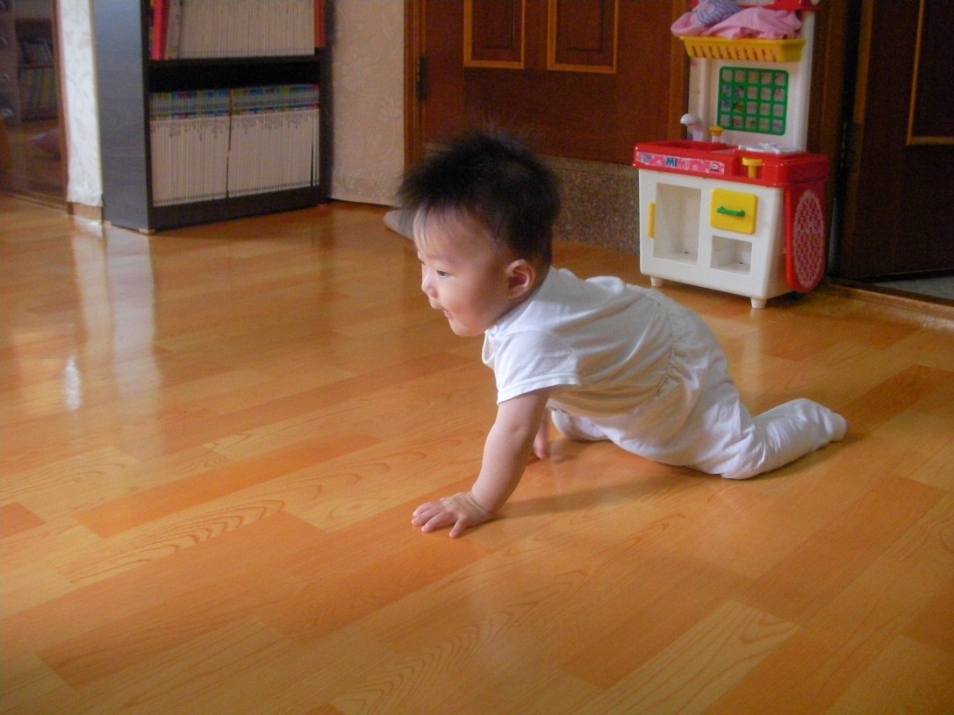
Weight either on the arms
Body S/F
b760 Control of voluntary movement functions
b7603 Supportive functions of arm or leg
functions associated with the control over and coordination of voluntary movements by placing weight either on the arms (elbows or hands) or on the legs
(knees or feet)

Slide 35
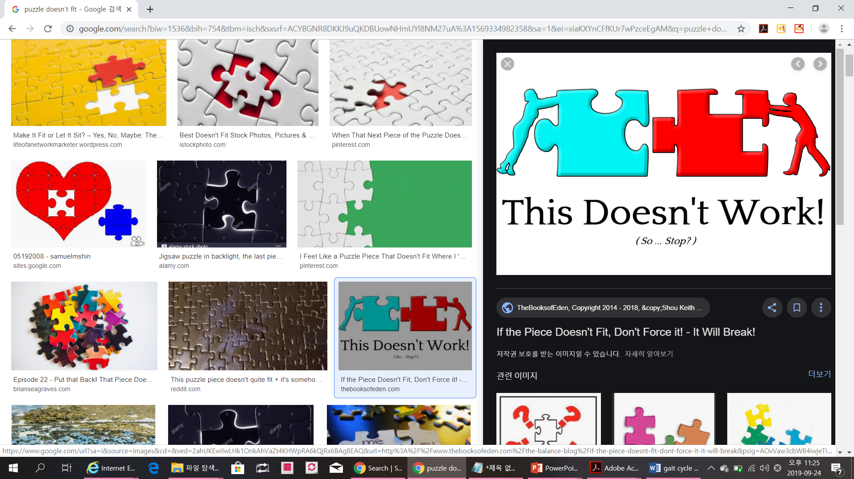
Reasons of difference between instructors
ICF is not always fit well in assessment tools in physiotherapy field.
ICF
PT

Slide 36

Limitations
Ptyushkin et al. (2011) found that the disadvantages of ICF may include complicated terminology especially if used by public organizations and subjectivity of the assessor.

Slide 37
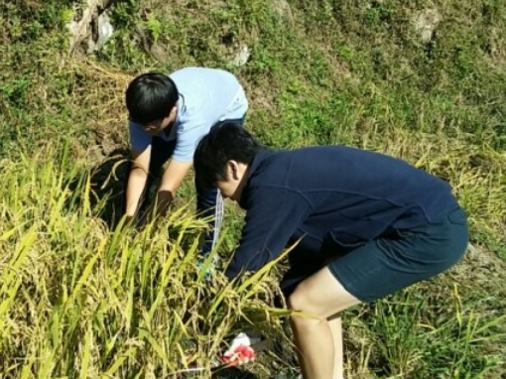
Rice harvesting is Activity.
the Trunk bending is a Body function.

Slide 38
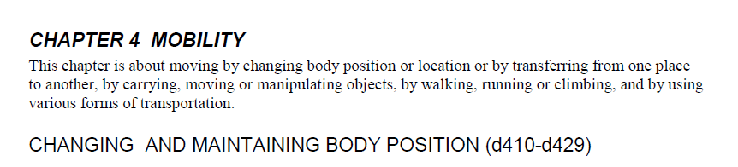
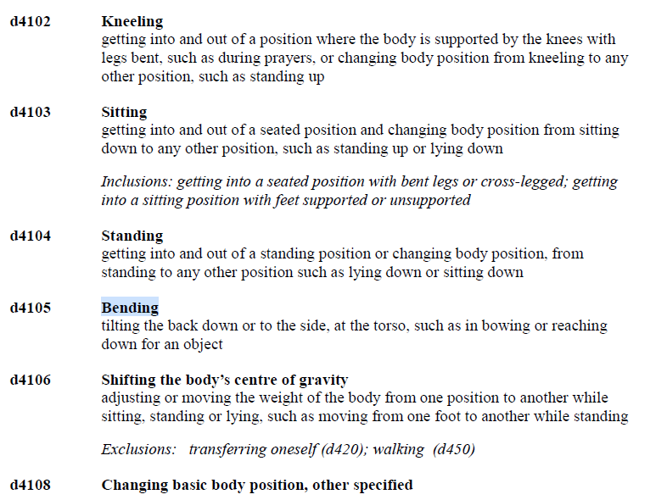

Slide 39
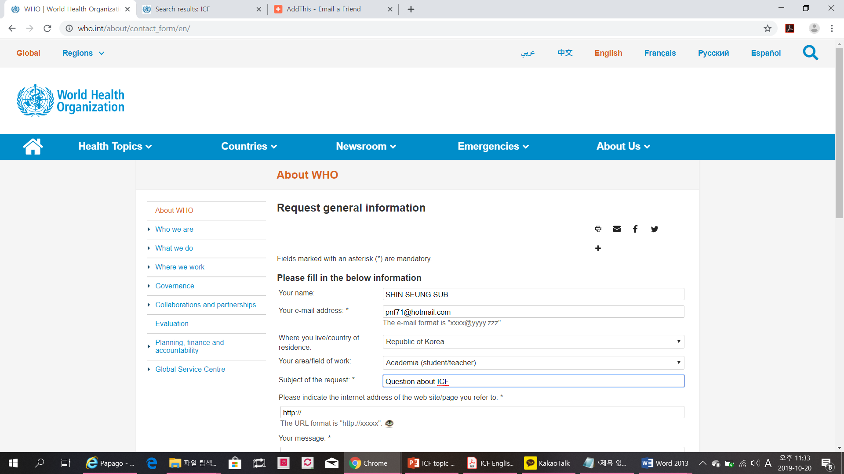

Slide 40
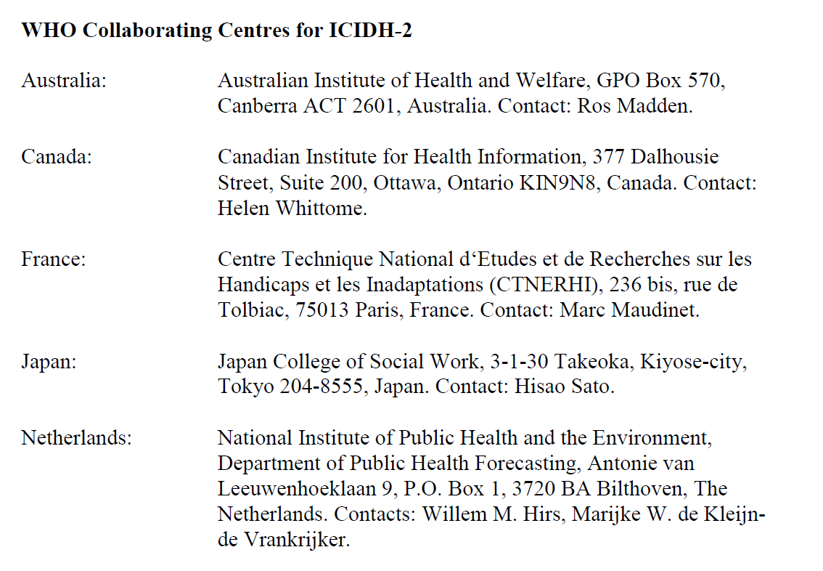

Slide 42
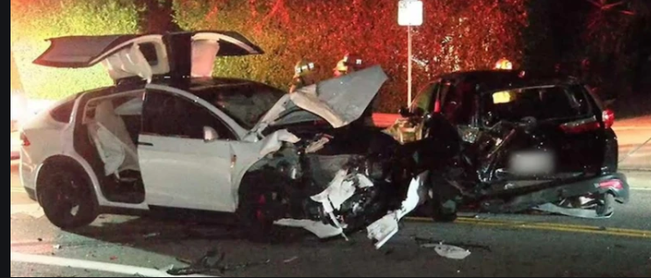
Mail from Dr. Hans Peter Rentsch
the whole ICF is a helpful framework for our work.
I have done this also with other Activity and Body F/S clashes!
Activity
Body F/S
Notes:
This border between the two countries runs through the city of Baarle and divides the city into two separate municipalities.
https://qunki.com/8734/14-of-the-most-amazing-international-borders-from-around-the-world/

Slide 43
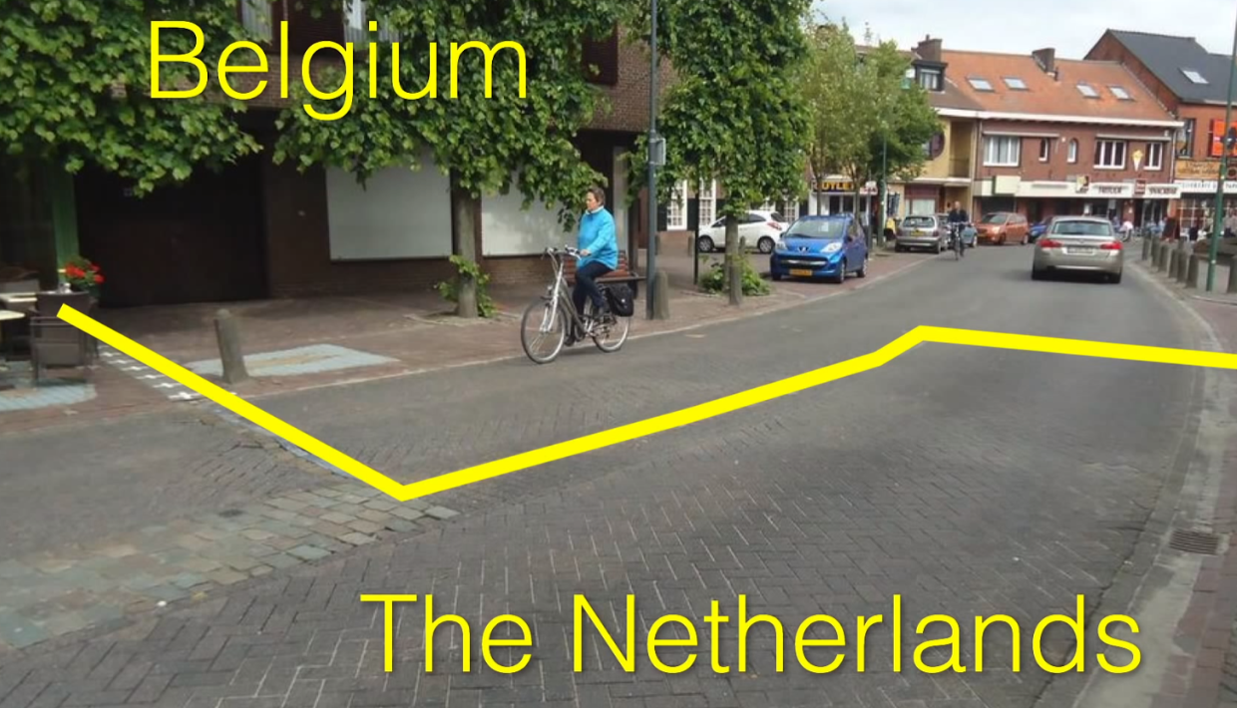
Mail from Dr. Hans Peter Rentsch
the reality, the borders between activity and body F/S are sometimes not clear.
Notes:
This border between the two countries runs through the city of Baarle and divides the city into two separate municipalities.
https://qunki.com/8734/14-of-the-most-amazing-international-borders-from-around-the-world/

Slide 44
Mail from Dr. Hans Peter Rentsch
I agree with your opinion, that torso bending is a Function!
This (d4105: torso bending) would fall under Function b760 : Movement Functions

Slide 45
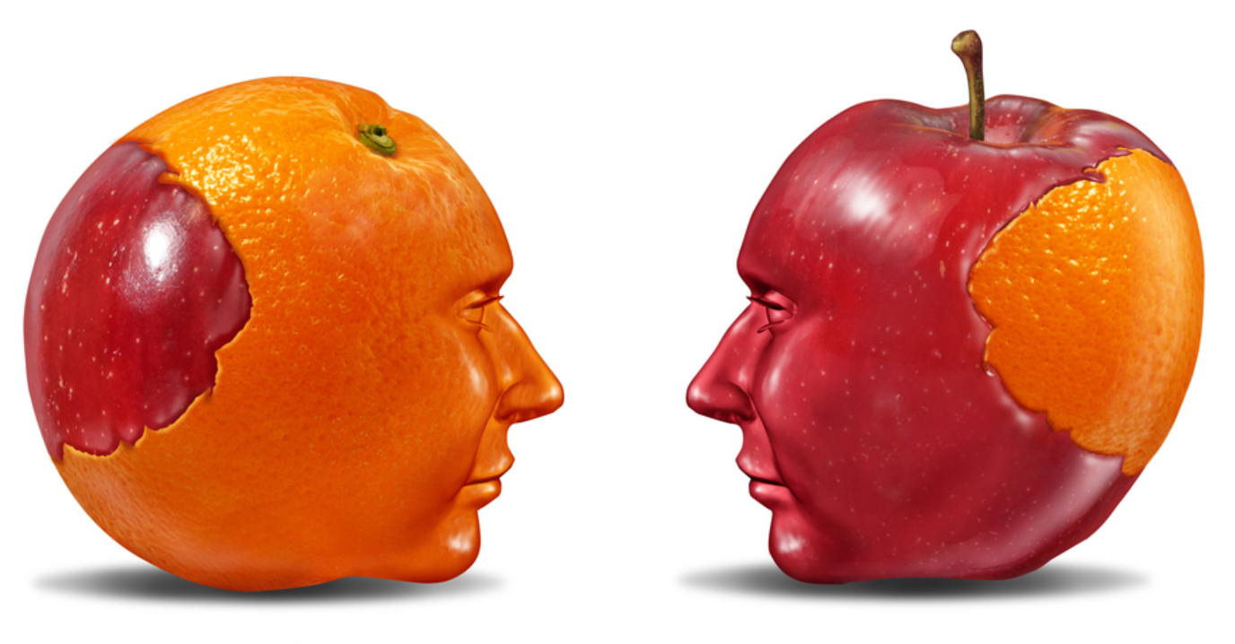
Reasons of difference between instructors
In the field of physical therapy, assessment tools are also grouped differently by experts into ICF classifications.

Slide 46
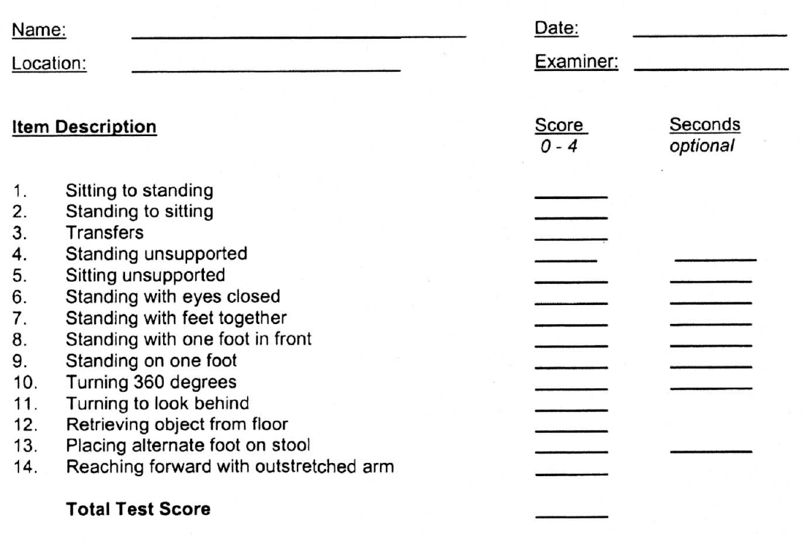
Pediatric Balance Scale

Slide 47
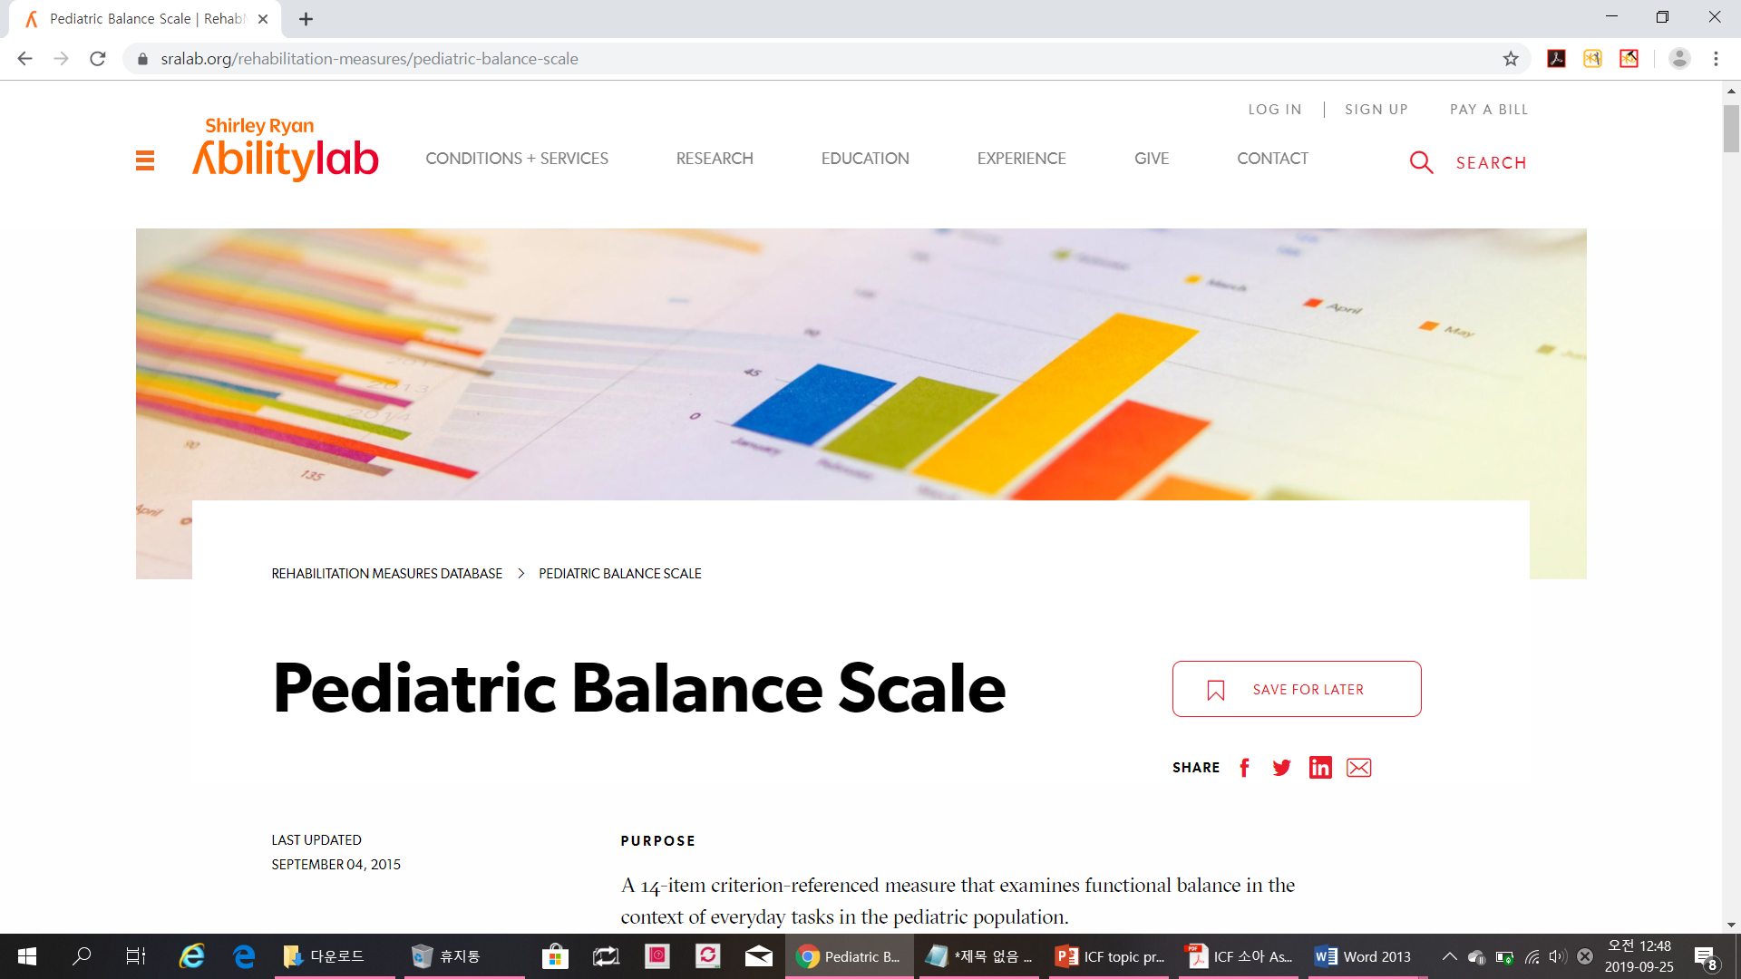
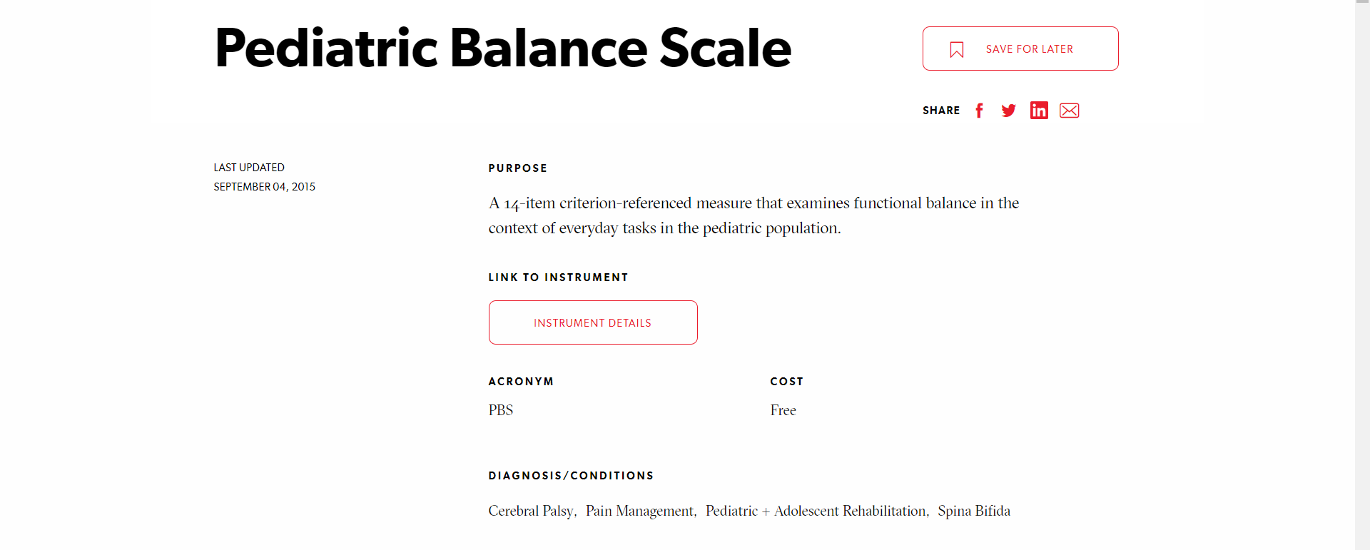
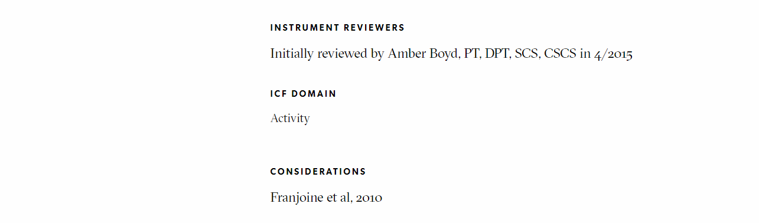
Notes:
Shirley 미국·영국 [ʃə́:rli] Ryan[raiən]
The Shirley Ryan AbilityLab is a nationally ranked physical medicine and rehabilitation research hospital based in Chicago,

Slide 48

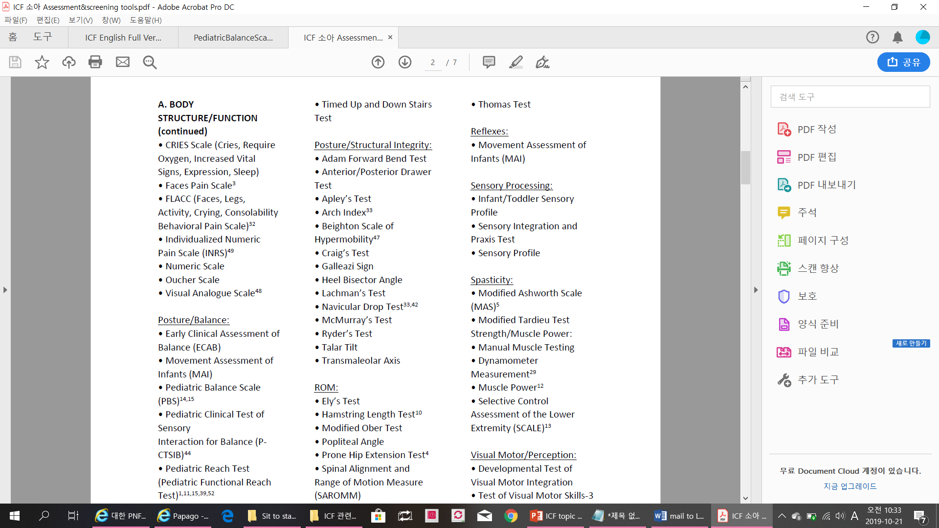

Slide 49
Pediatric Balance Scale
Activity
Body S/F
Notes:
Shirley 미국·영국 [ʃə́:rli] Ryan[raiən]
The Shirley Ryan AbilityLab is a nationally ranked physical medicine and rehabilitation research hospital based in Chicago,

Slide 50
Traumatic brain injury
Basic course
I’m fear during Sit to standing !
Test
Activity limitation?
Causal impairments?

Slide 51
Traumatic brain injury
Basic course
I’m fear during Sit to standing !
VAS
Time, Independent, Difficulty and etc.
Test
Activity limitation?
Causal impairments?

Slide 52
Clinical reasoning
Fear
Balance
Body S/F
Body S/F
Spasticity on the calf
Proprioception ↓
M. Weakness
Notes:
We need to find out where the wind is coming from.

Slide 53
Traumatic brain injury
Basic course
Activity limitation:
  Difficult to Sit to standing
  Test : measure the Time of STS
Causal impairments:
  Fear
  Test – Visual analogue scale
  Insufficient balance-
  decreased forward limit of stability Test : Modified Functional reach test

Slide 54
Traumatic brain injury
Advanced course
I’m fear during Sit to standing !
VAS
Time, Independent, Difficulty and etc.
Test
Activity limitation?
Causal impairments?

Slide 55
Clinical reasoning
Fear
Balance
Activity
Body S/F
Spasticity on the calf
Proprioception ↓
M. Weakness
Notes:
We need to find out where the wind is coming from.

Slide 56
Traumatic brain injury
Activity limitation:
  Difficult to Sit to standing
  Test : Time measure
Sub- activity limitation:
  Insufficient balance- decreased forward limit of stability
  Test : Modified functional reach test
Causal impairment:
  Fear
  Test – Visual analogue scale
  Muscle weakness – hip & knee extensors
  Test : Manual muscle testing

Slide 57
Concluding remarks
Several experts point to drawbacks of ICF in conceptualization of specific components, which are in need of further study and development.
(Bruyère et al., 2005)
More studies are needed to link physical therapy outcome measures to the ICF in different settings (e.g., assessment, treatment) for different health conditions.
(Abdelmegeed, 2019)

Slide 58
Concluding remarks
Since the borders between Activity and Body F/S are sometimes not clear, instructors need a more open perspective when using ICF, in some components (e.g. balance), during the PNF process.
But, assessments for Activity Limitation & Causal Impairments in PNF based on ICF requires more discussion among instructors not to throw the participants into confusion during PNF courses.

Slide 59
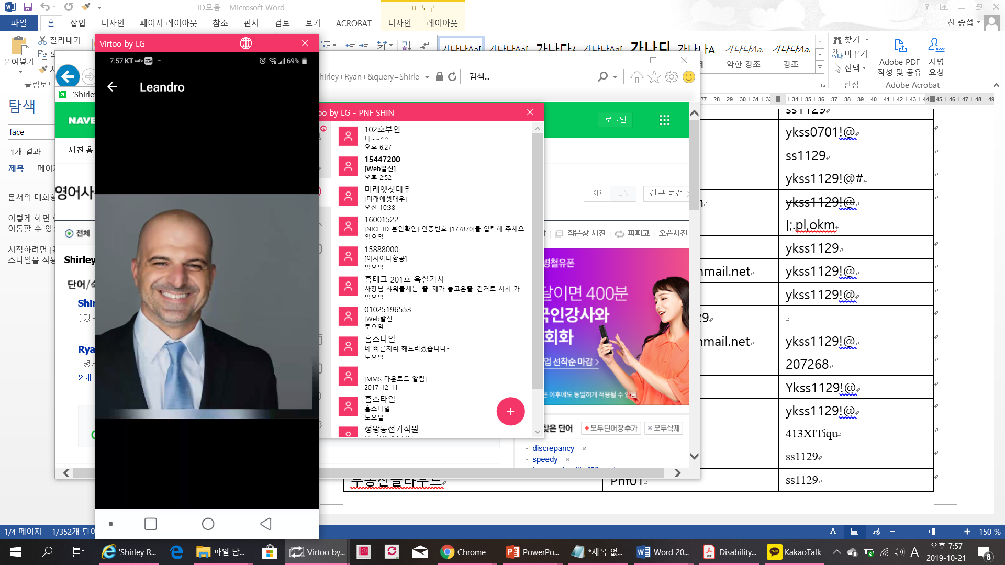
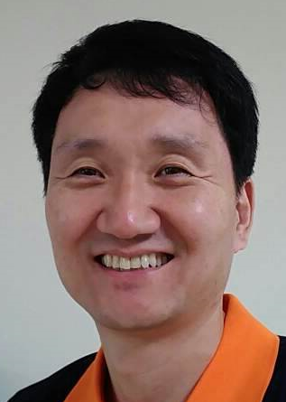
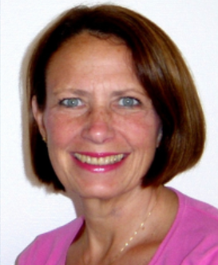
Supporter
Our team
Leandro Giacometti
Shin, Seung Sub
Louise Rutz-LaPitz

Slide 60
References
Abdelmegeed M (2019) The International Classification of Functioning, Disability, and Health (ICF): Are We Using the Correct language? J Neurol Neurophysiol 10: 484.
Bruyère, S. M., Van Looy, S. A., & Peterson, D. B. (2005). The international classification of functioning, disability and health: Contemporary literature overview. Rehabilitation Psychology, 50(2), 113
Ptyushkin P, Vidmar G, Burger H, Marinček Č, Escorpizo R (2011)The international classification of functioning, disability, and health (ICF) in vocational rehabilitation and disability assessment in Slovenia: state of law andusers' perspective. Disability and rehabilitation 33: 130-136.
World Health Organization. (2001). International classification of functioning, disability and health: ICF. Geneva: World Health Organization.

